Slide 1
Video Classification using Deep Learning
Deep Learning course
MSc in AI
Georgios Batsis

Slide 2
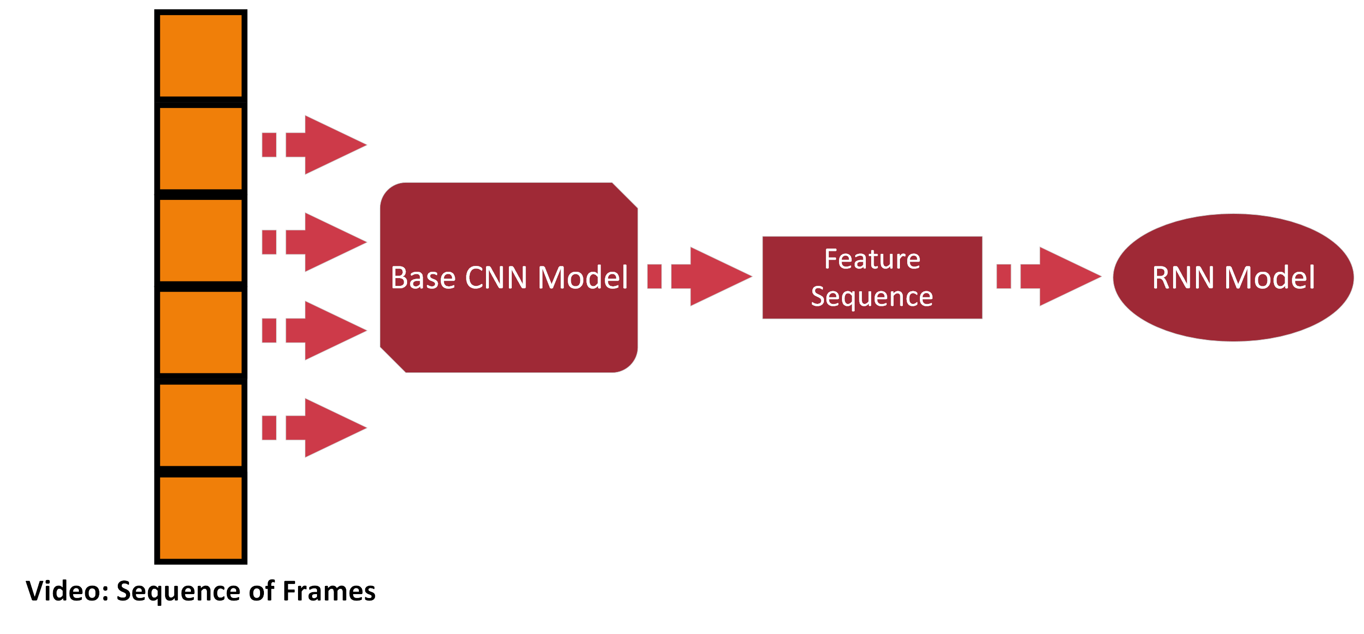
In general…

Slide 3
Experiments: Step 1 → Choose Base CNN Model
Most popular pretrained models:
VGG
ResNet
MobileNet.
Choose which layers will be left frozen:
CNNs consist of:
Convolutional Block → Convolutional and Pooling Layers
Classifier → Fully Connected Layers
Freezing options:
Last (or other) Convolutional Layer
Penultimate Layer of classifier

Slide 4
Experiments: Step 2 → Deep Model Construction
Define the RNN-based part:
Model (e.g. LSTM)
Hidden state dimension
Number of layers
Direction
Final classifier
After pre-trained CNN selection, decide if:
Use the extracted features directly
Add trainable layer(s) after feature extraction

Slide 5
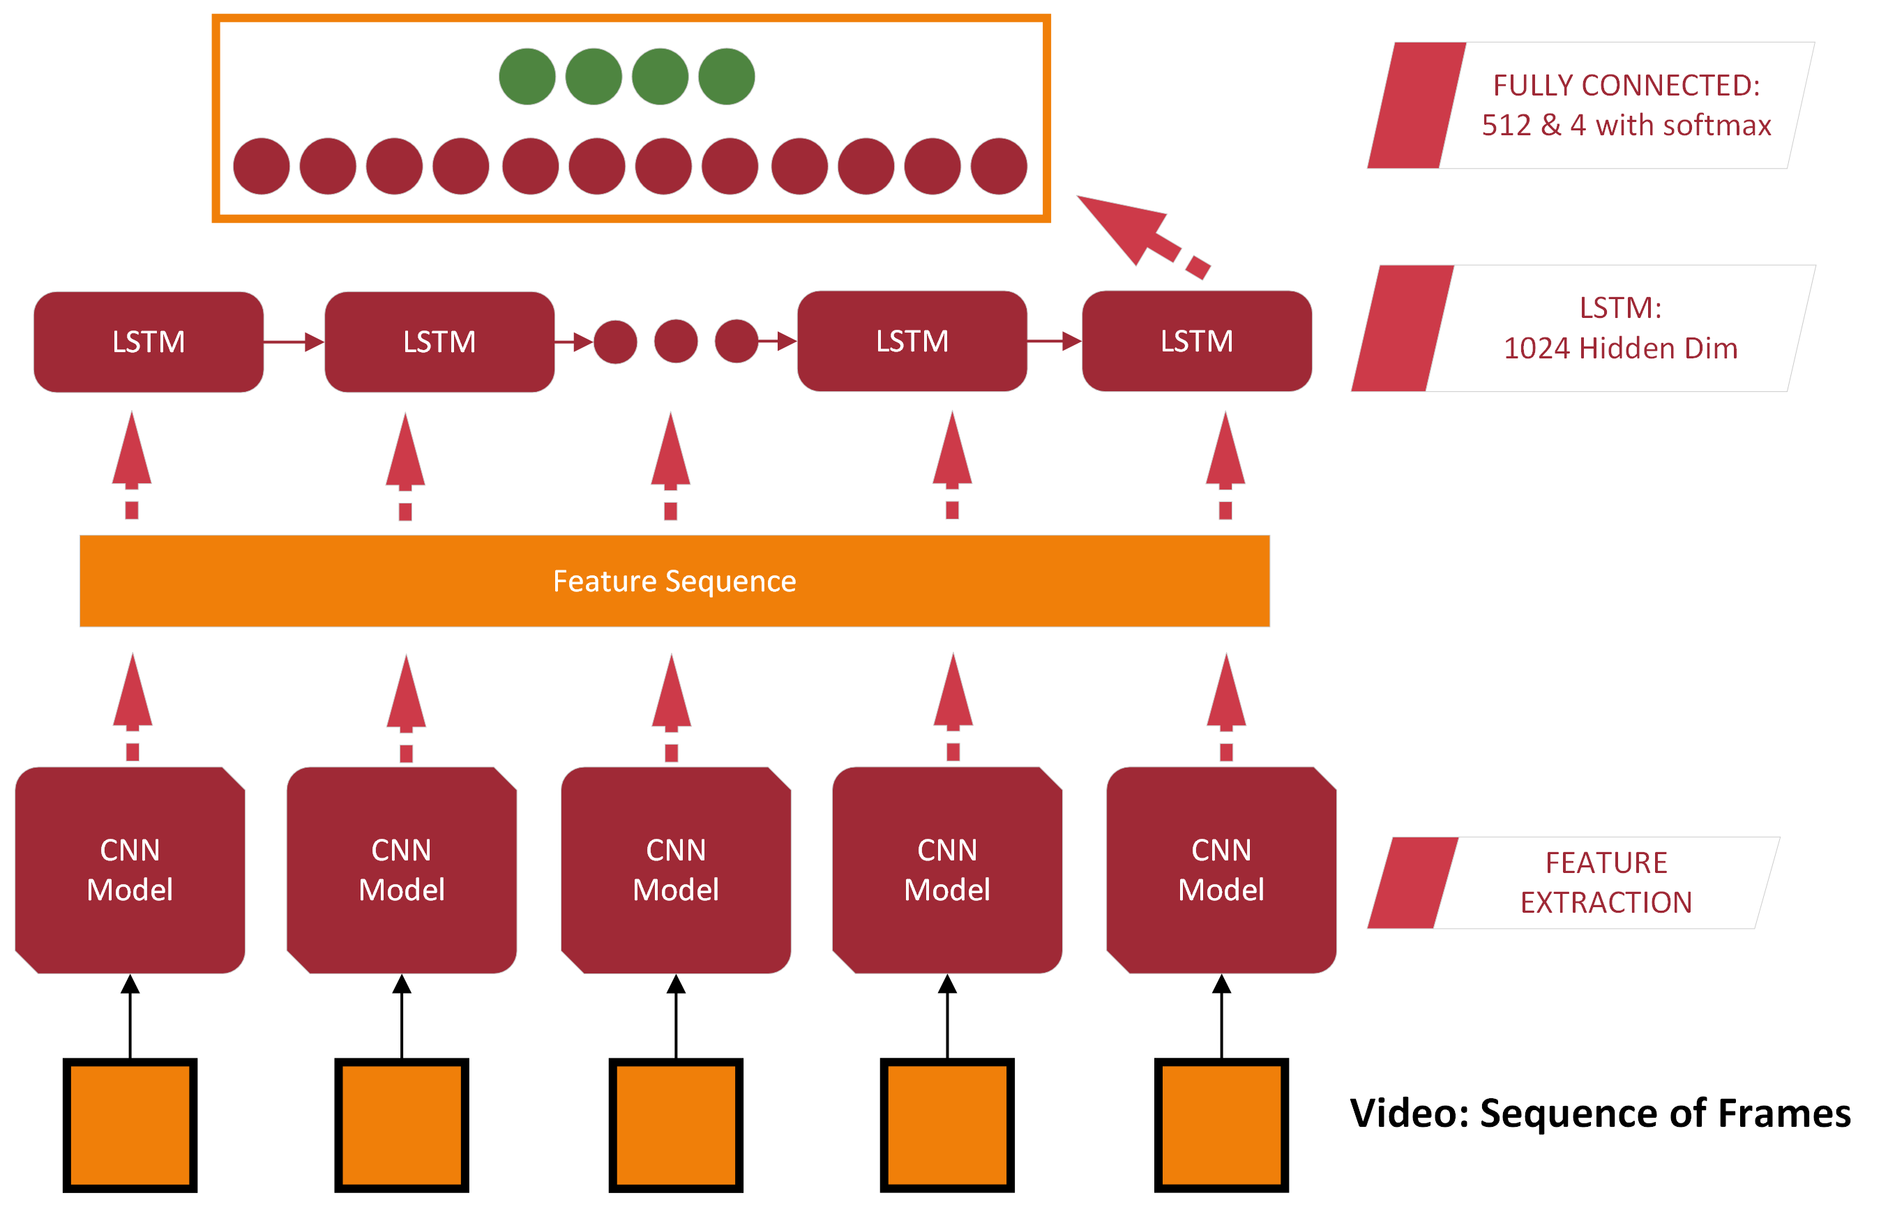
Approach A

Slide 6
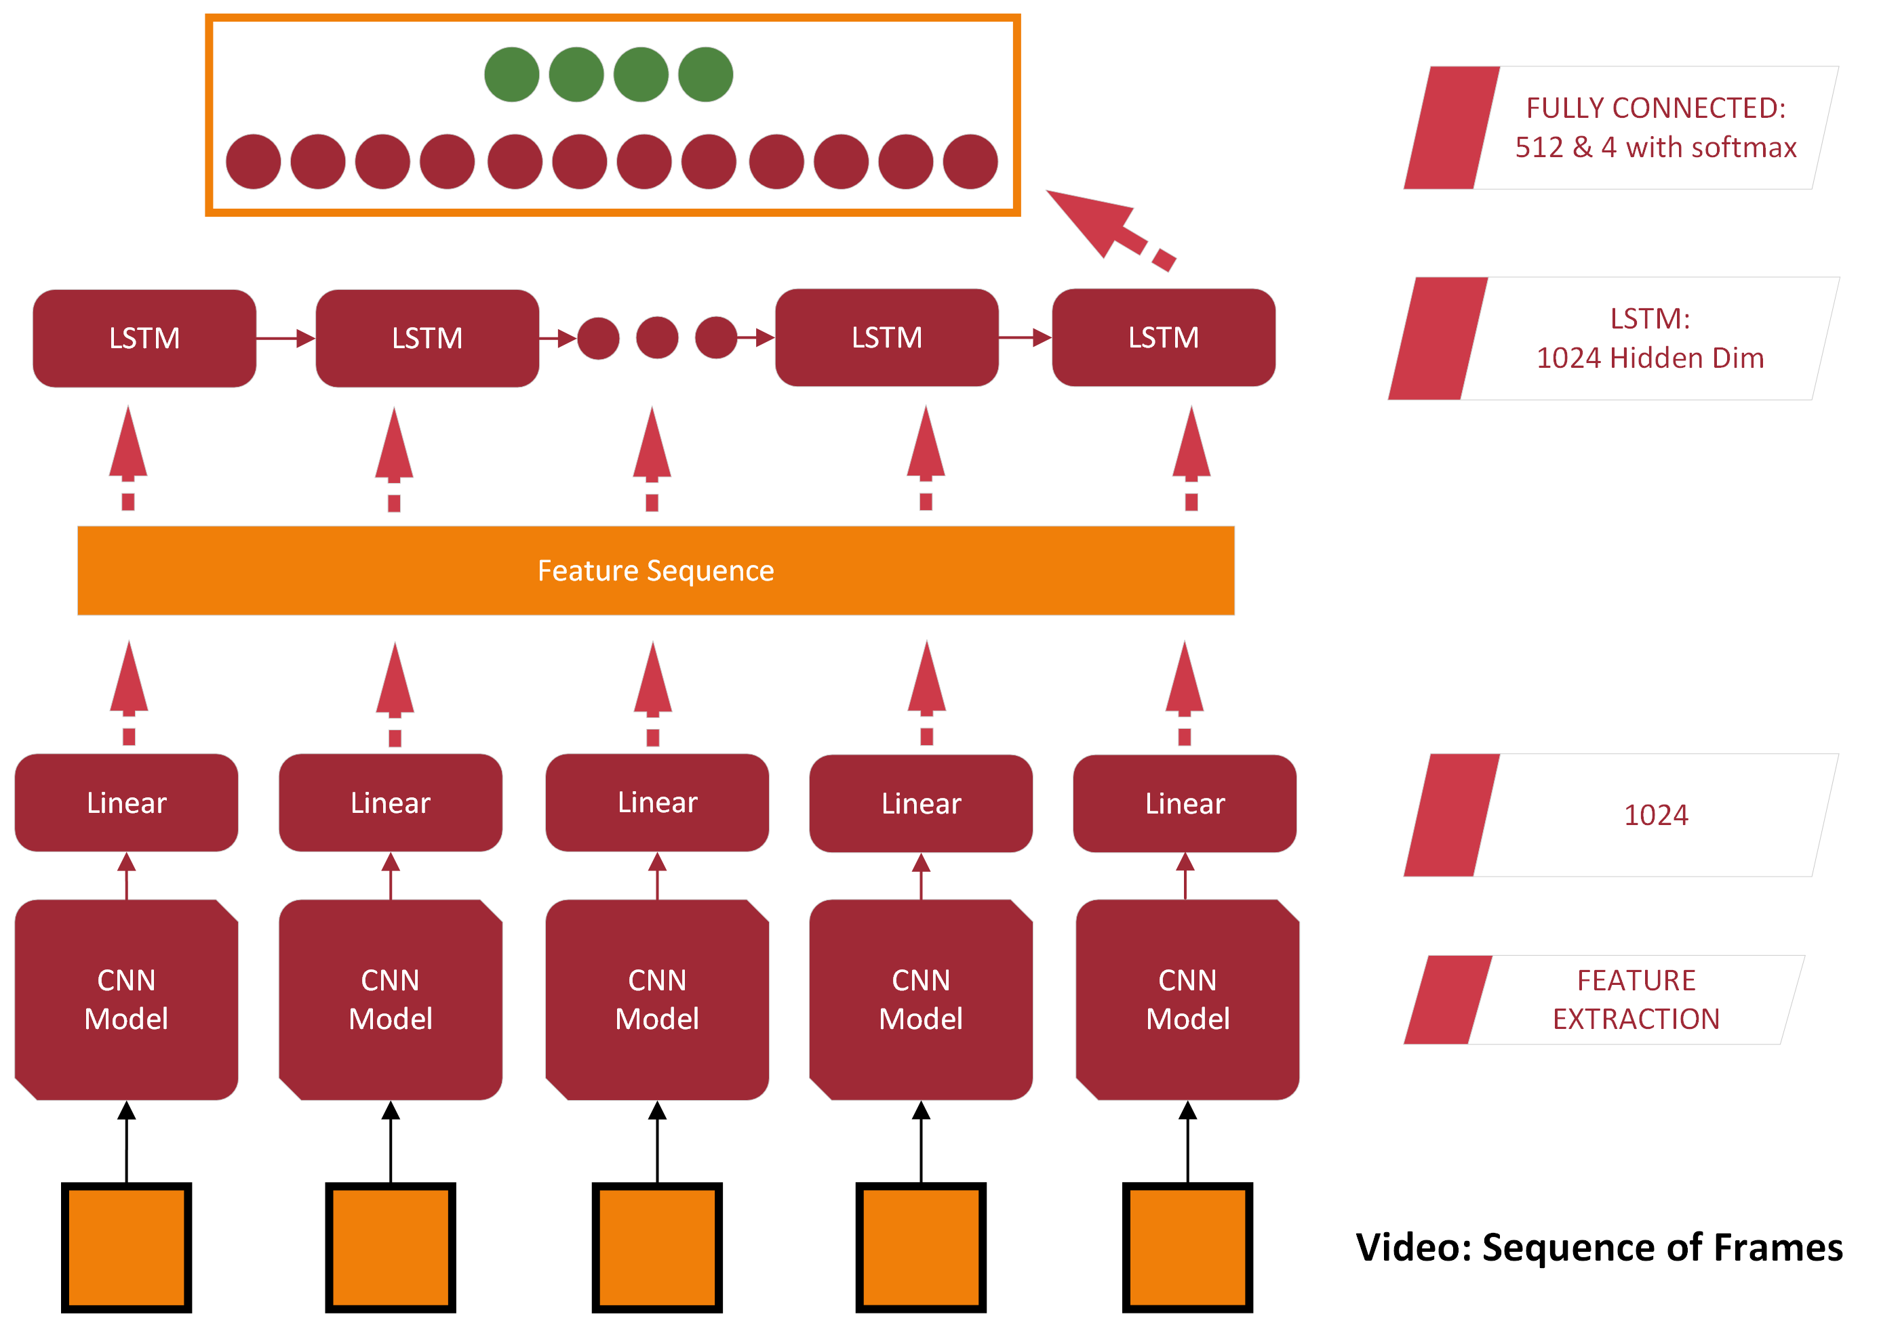
Approach B

Slide 7
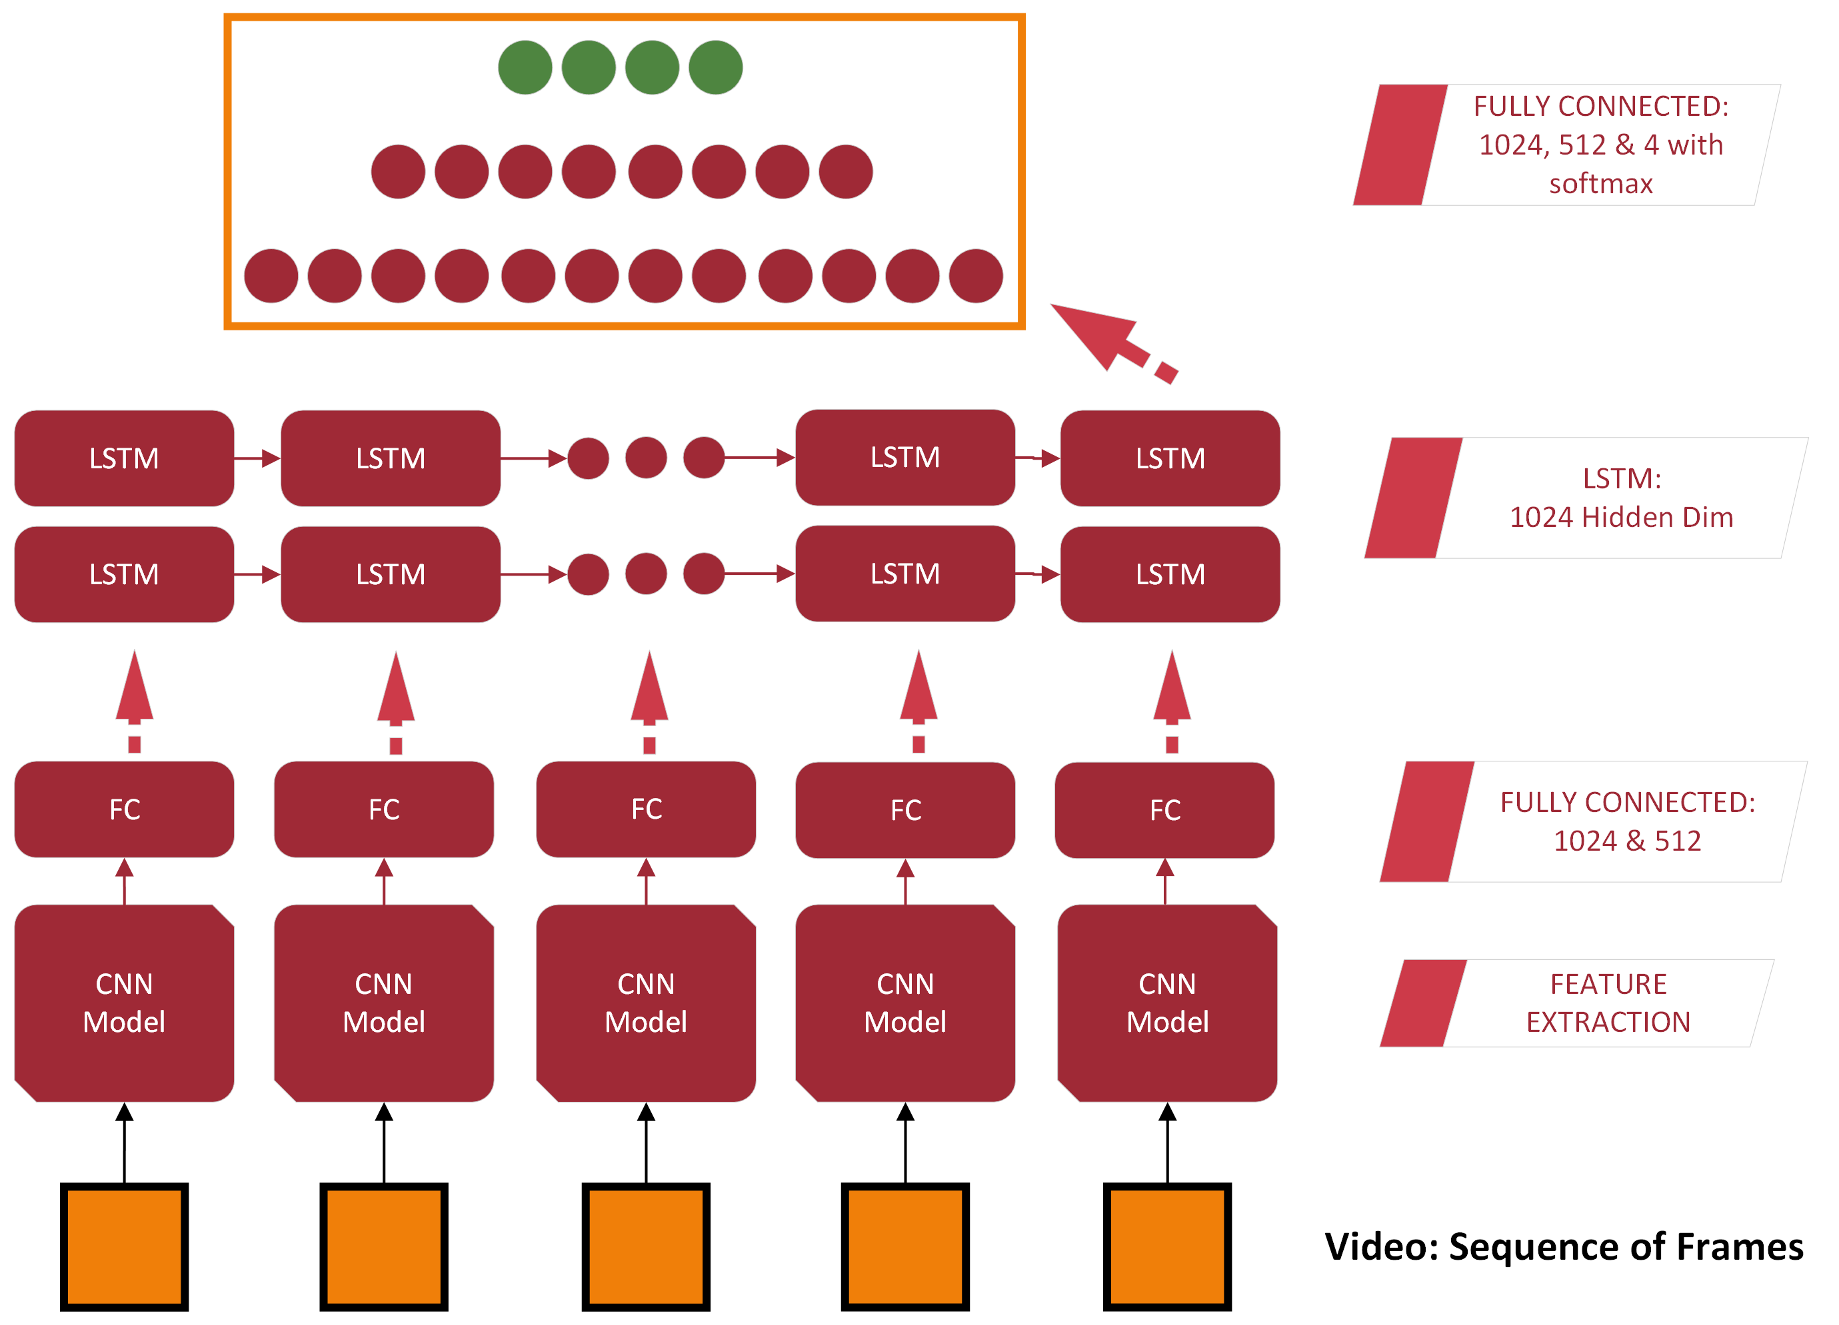
Approach C

Slide 8
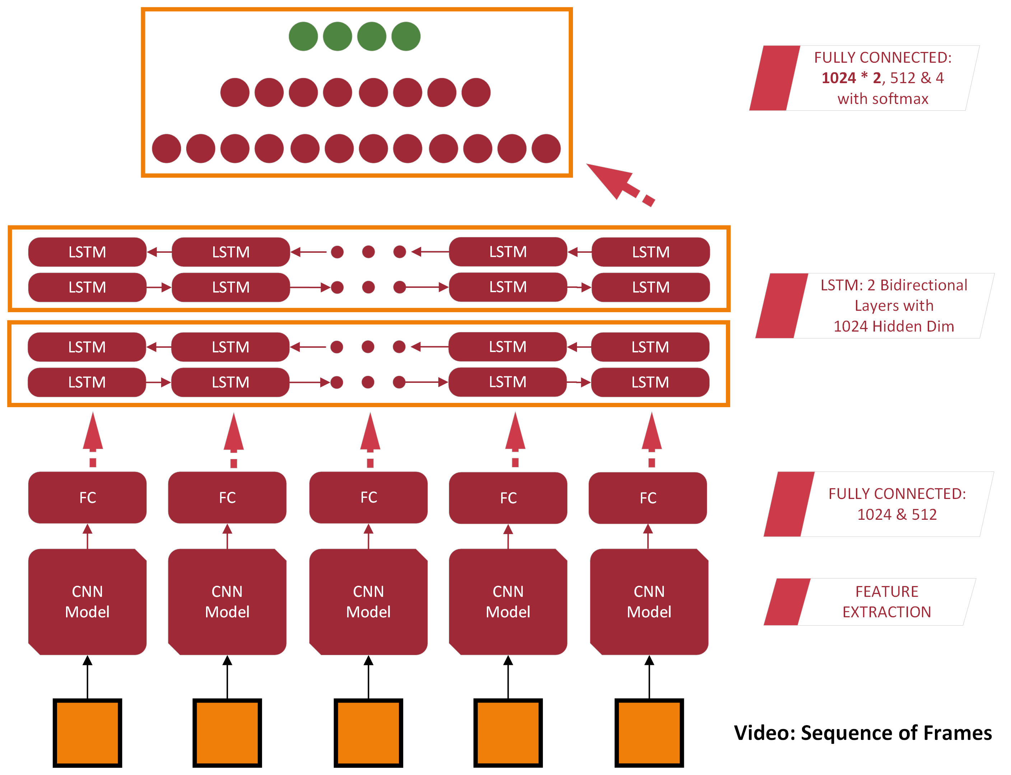
Approach C’

Slide 9
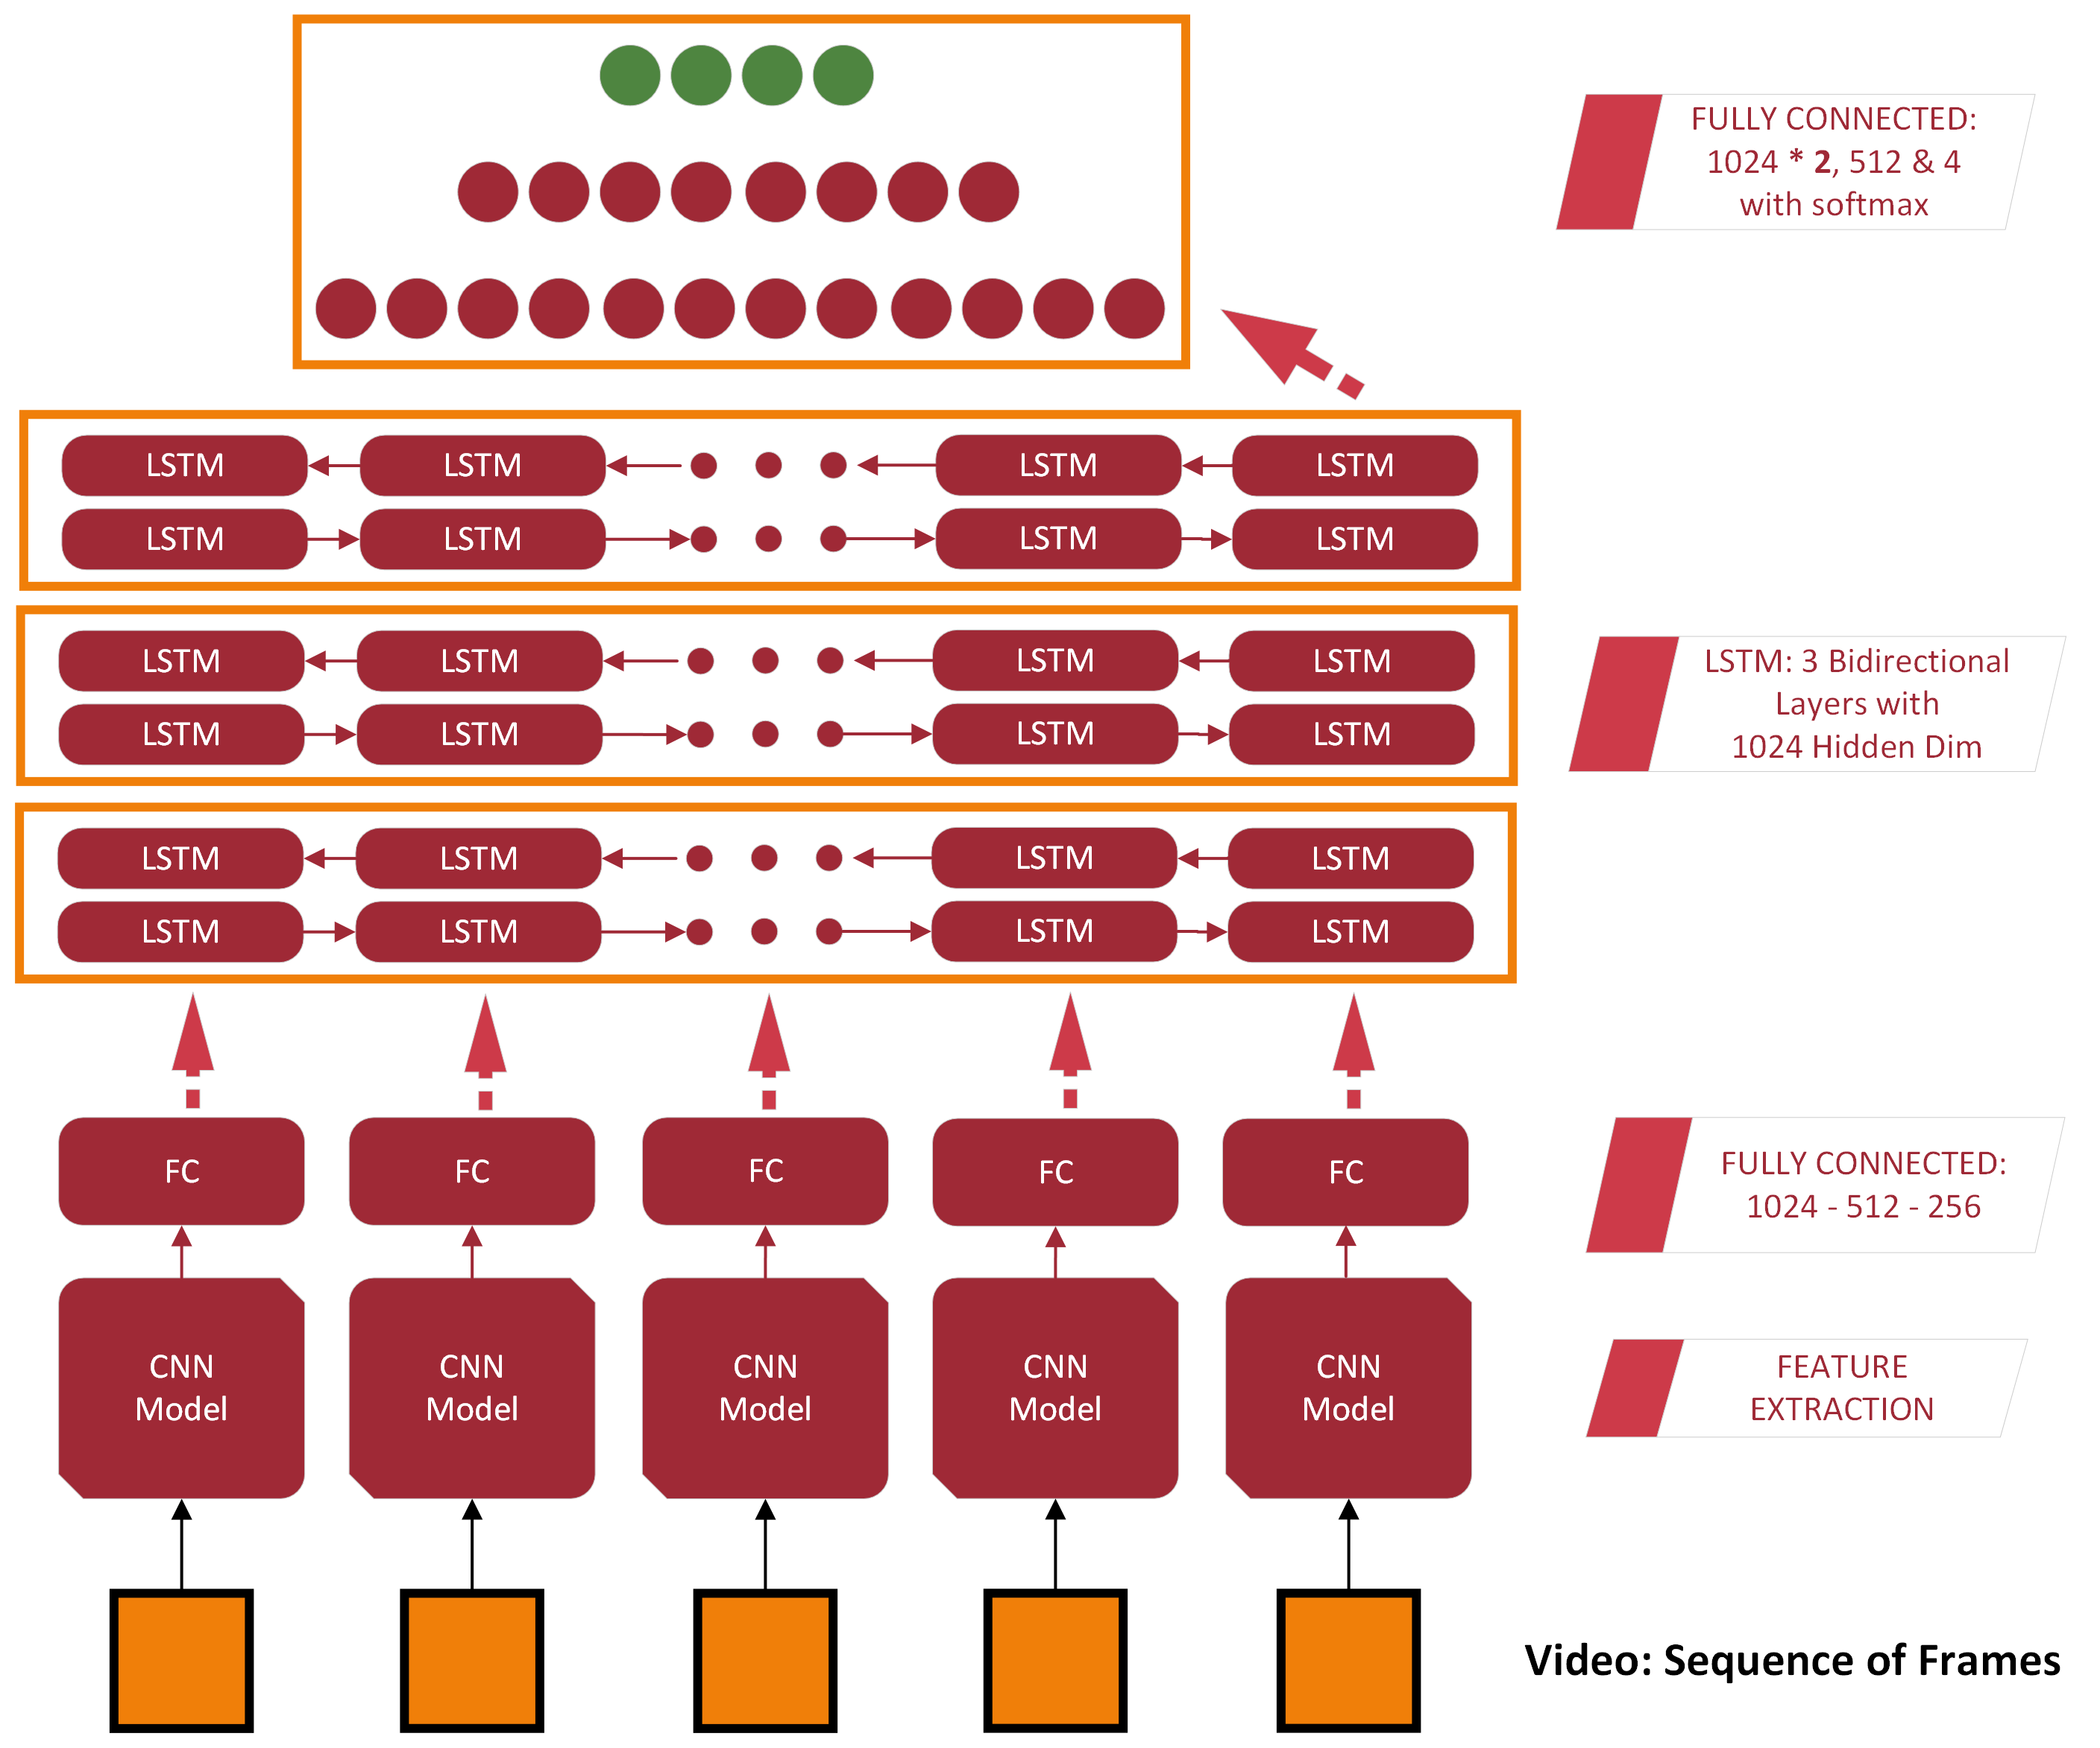
Approach D

Slide 10
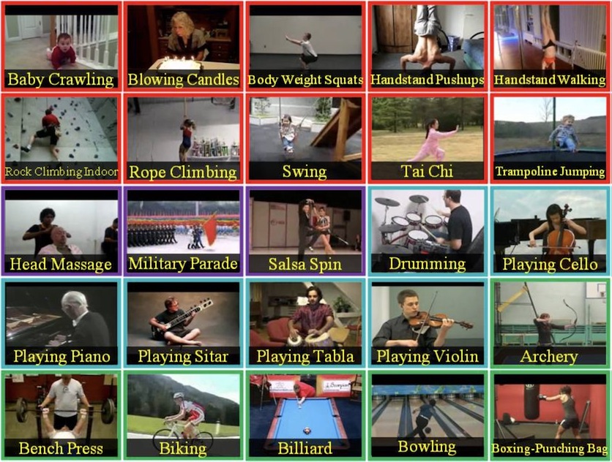
Dataset
UCF101 Human Actions dataset:
A small subset was used in this project
Official train-test splitting
Classes:
0: Playing Guitar
1: Rock Climbing Indoor
2: Soccer Juggling
3: Band Marching

Slide 11
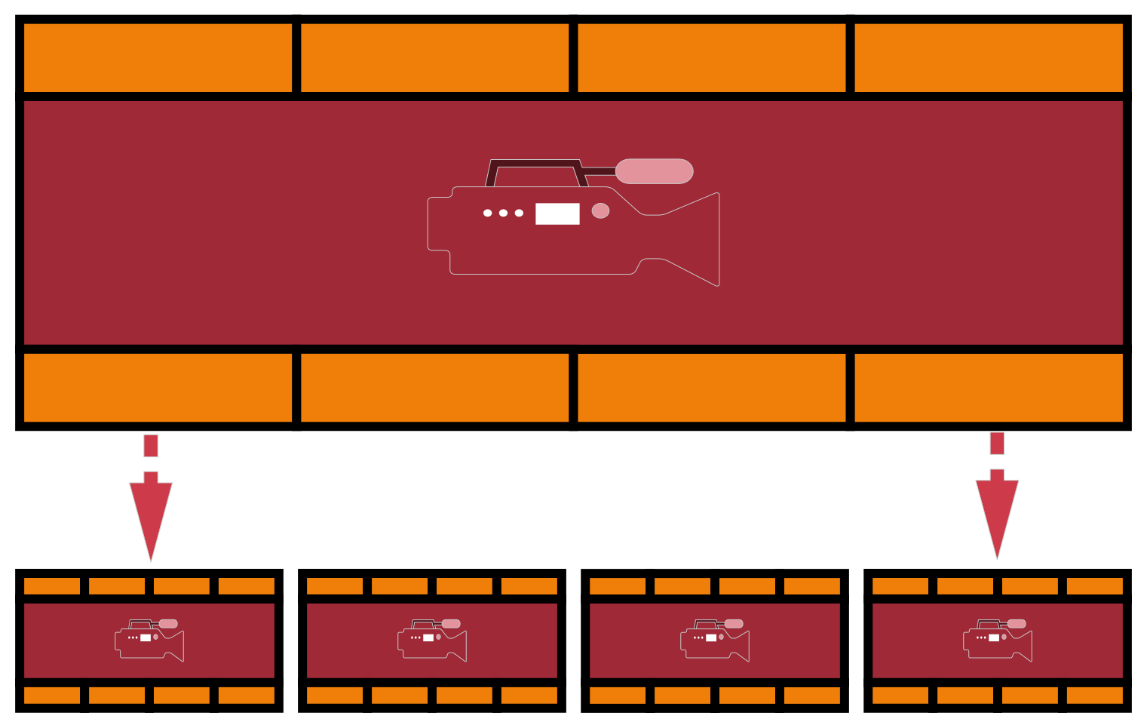
Preprocessing
Sequence level transformation:
Problem: Differences in the total number of frames per video & the Fps
Solution: Extract video segments → Shorter videos with fixed number of frames
Frame-level transformation:
Resize (e.g. 224x224)
Normalize → mean=[0.485, 0.456, 0.406], std=[0.229, 0.224, 0.225]

Slide 12
Results
Pre-trained CNN selection:
All models tested using the DNN of Approach A
ResNet – 125 freezed at the last layer (Average Pooling after the last Convolutional Layer) outperforms VGG 19 freezed at the penultimate Layer of classifier [97% vs 92% F1 Score in validation dataset].
If we freeze the last Convolutional Layer of VGG the model can’t learn…
MobileNet overfit…

Slide 13
Results
Model Name | F1 Score | Loss
Approach A | 97.3 | 1.10
Approach B | 97.7 | 0.64
Approach C | 97.5 | 0.56
Approach C (Bid) | 97.8 | 0.57
Approach D | 98.6 | 0.29

Slide 14
Results
Model Name | F1 Score | Loss
Approach A | 97.3 | 1.10
Approach B | 97.7 | 0.64
Approach C | 97.5 | 0.56
Approach C (Bid) | 97.8 | 0.57
Approach D | 98.6 | 0.29

Slide 15
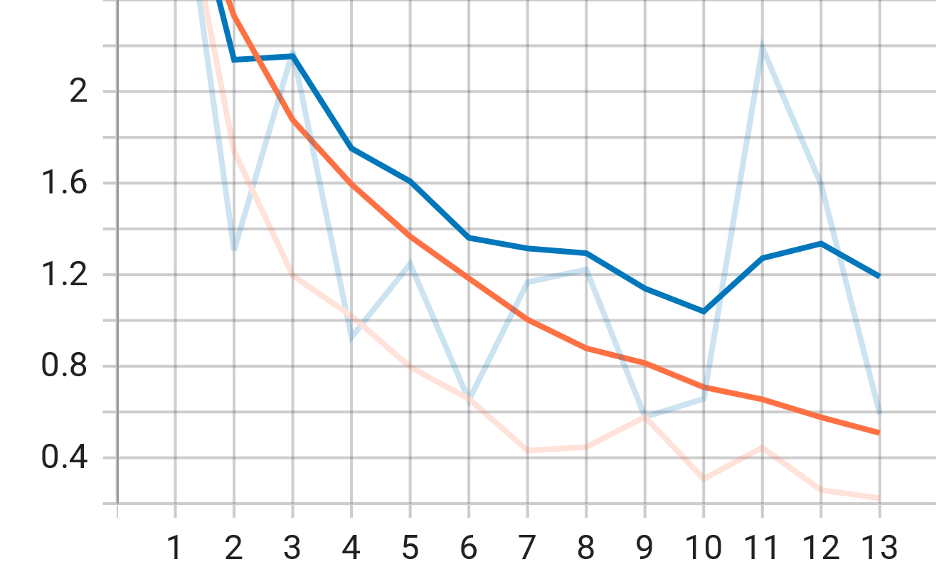
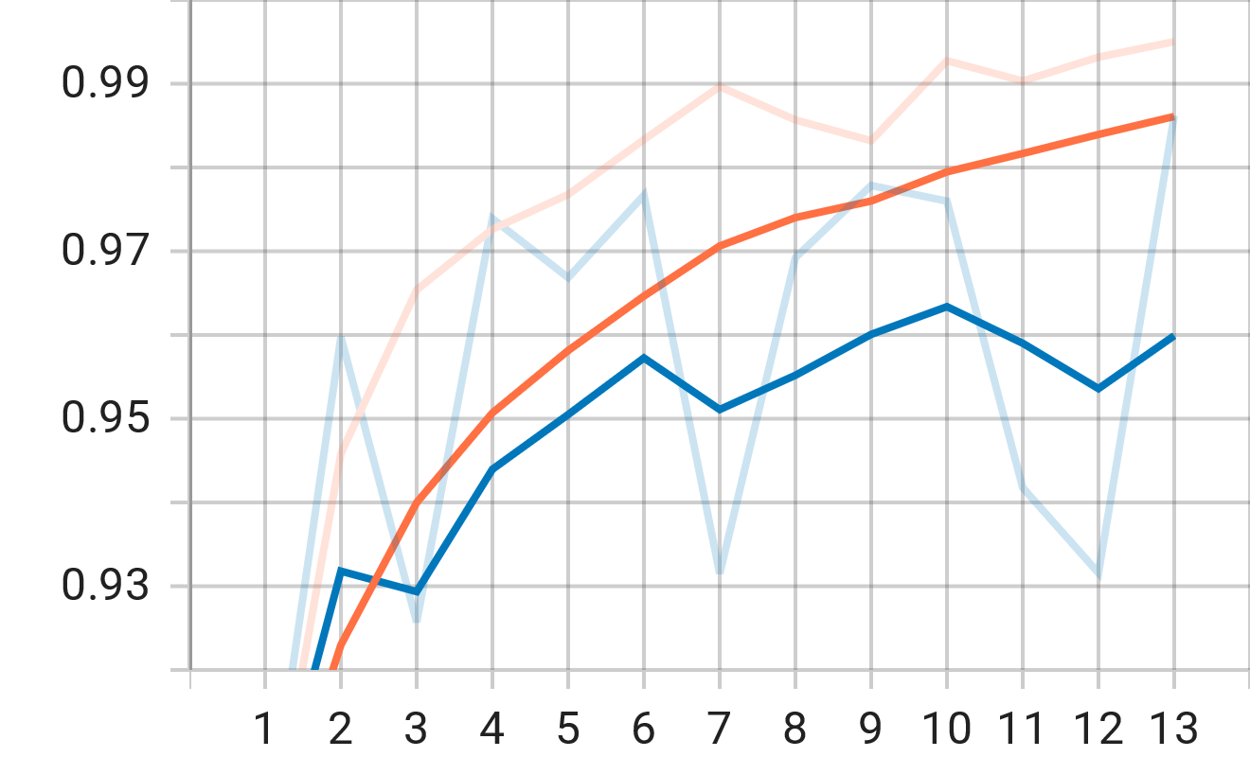
Results
Model Name | F1 Score | Loss
Approach A | 97.3 | 1.10
Approach B | 97.7 | 0.64
Approach C | 97.5 | 0.56
Approach C (Bid) | 97.8 | 0.57
Approach D | 98.6 | 0.29

Slide 16
Results
Model Name | F1 Score | Loss
Approach A | 97.3 | 1.10
Approach B | 97.7 | 0.64
Approach C | 97.5 | 0.56
Approach C (Bid) | 97.8 | 0.57
Approach D | 98.6 | 0.29

Slide 17
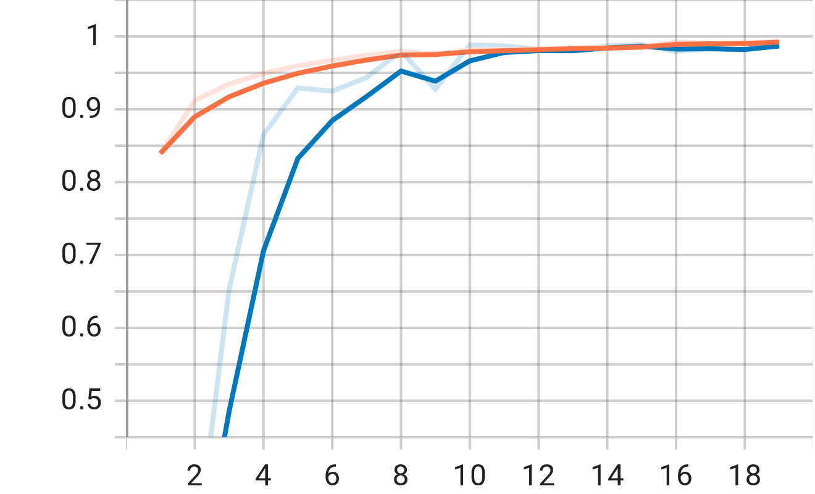
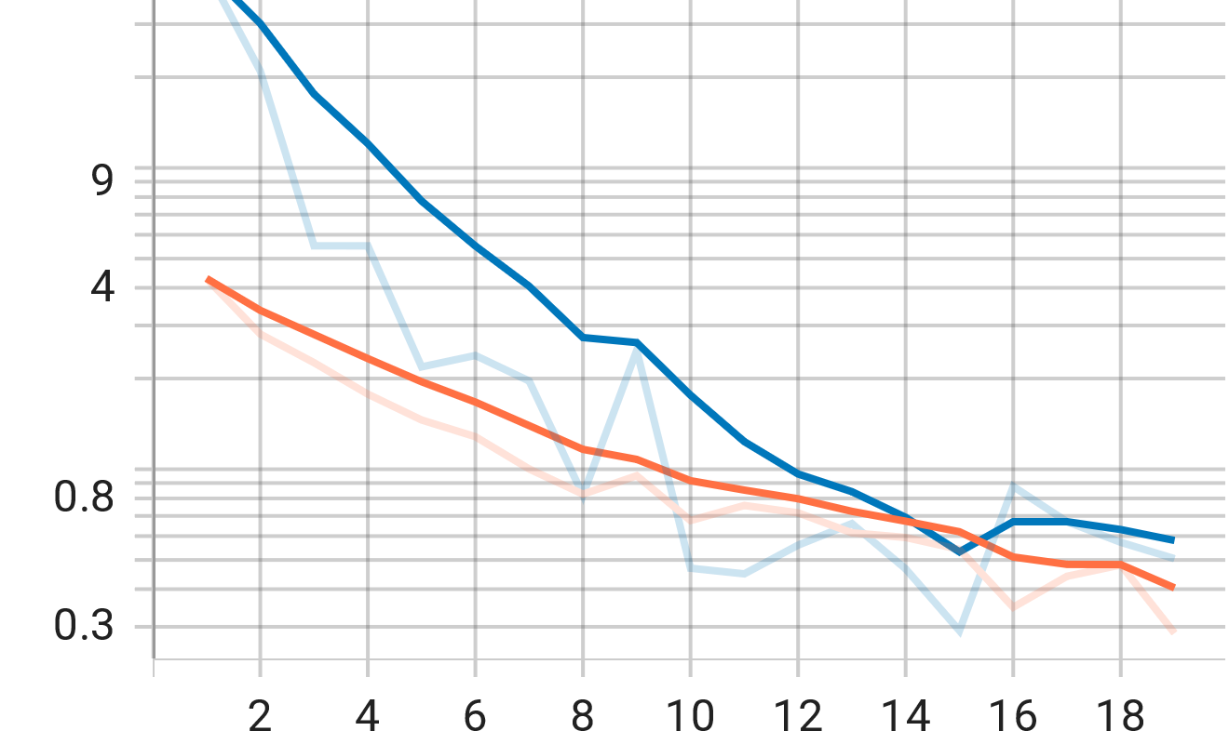
Results
Model Name | F1 Score | Loss
Approach A | 97.3 | 1.10
Approach B | 97.7 | 0.64
Approach C | 97.5 | 0.56
Approach C (Bid) | 97.8 | 0.57
Approach D | 98.6 | 0.29

Slide 18
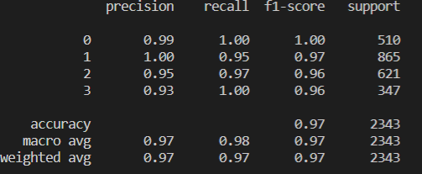
Results: Test Dataset
Model Name | F1 Score | Loss
Approach A | 97.3 | 1.10
Approach B | 97.7 | 0.64
Approach C | 97.5 | 0.56
Approach C (Bid) | 97.8 | 0.57
Approach D | 98.6 | 0.29
 | 0 | 1 | 2 | 4
0 | 509 | 0 | 1 | 0
1 | 1 | 822 | 28 | 14
2 | 3 | 2 | 605 | 11
3 | 0 | 1 | 0 | 346

